Slide 1
Surf Clam growth increments test image set
Date: 20250924
Objective: to discriminate the annual growth increments between annual growth signatures (signatures often termed annuli).
This presentation includes 30 images that are section of the hinge regions (to be explained in the next three slides) of individual surf clams
The hinge region contains a complete record of clam growth over its lifetime.
Each image is an individual .jpg image with marker or arrows added in .ppt. These markers can be deleted as desired and the individual images downloaded.
Source: Roger Mann, VIMS, rmann@vims.edu, 804-815-3550 (cell)

Slide 2
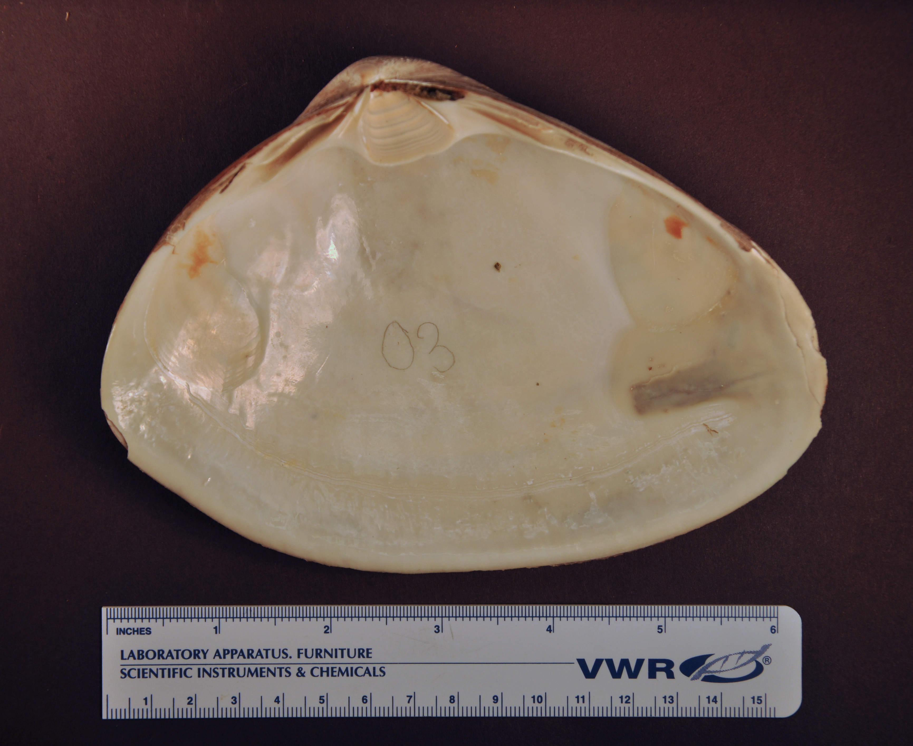
How did we obtain the images?: shell processing methods
Surf clam shells provide a complete growth record
This is a view of the inside of one of the two shells (termed valves, clams are bivalve – 2 valve - molluscs) after the shells have been separated.
Hinge (circled) is protected from outside abrasion
Shells are sectioned along line and the exposed cut (section) polished to see growth signatures
The images are of a section of the region circled in red – orientation given by blue arrow
Notes:
Surfclams keep a complete growth record in their shells. The hinge region (circled) is especially important, as it is protected from external shell abrasion, so no growth information is lost. For this work, each shell had been sectioned along that red line, from the hinge to the distal shell edge, polished, and imaged under a microscope to view annual growth lines as you’ll see in the next slide.

Slide 3
Methods: imaging and aging
Sectioned surfclam hinge with annual growth lines (annuli, dark) marked.
This specimen was collected in 1986, with an estimated age of 21 years,
making the birth year 1965.
Note there are also sub-annual lines. In this specimen discrimination of annual versus sub annual is relatively easy, but this is not always the case, especially so in slow growing individuals or other species.
Notes:
This is an image of a cross sectioned hinge. Each dark line represents a disturbance in shell growth. The most prominent lines, which are marked with squares, are the annual growth lines (termed annuli). The hinge grows proportionally to the rest of the shell. Under magnification, these lines were counted and the distance between them measured to see how much growth occurred in each year of the clam’s life. This individual has 20 growth lines, plus a growing edge on the right. Since it was collected in 1986, we estimated its birth year as 1965.

Slide 4
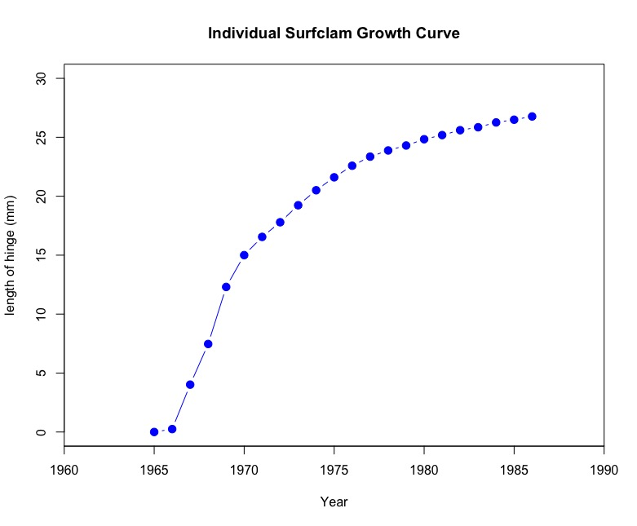
Methods: imaging and aging
Notes:
Plotting the increments between each annual line, we get a plot that looks like this. This is an individual growth curve, with each year of the clam’s life on the x-axis and the cumulative hinge length on the y-axis. We notice that the first 4-5 growth increments are the largest (with the 4th increment being the largest on average across the collection of many clams). This will be important later in describing growth over the entire life span. All future growth curves will all be measurements on the hinge but remember that it is proportional to the entire shell length.

Slide 5
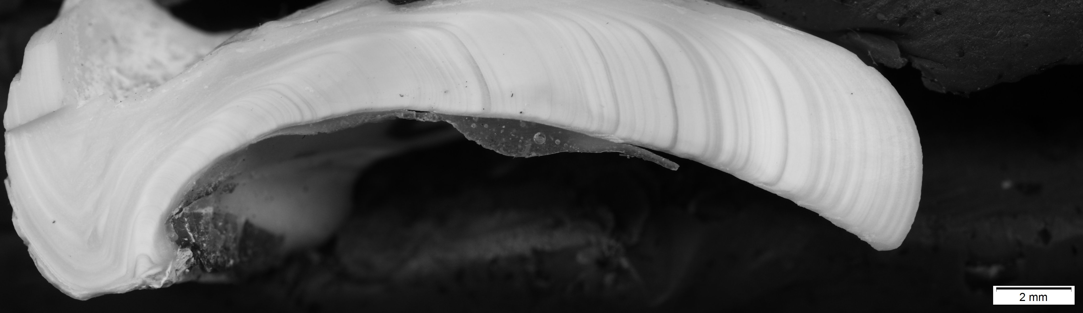
1
Notes:
20y

Slide 6
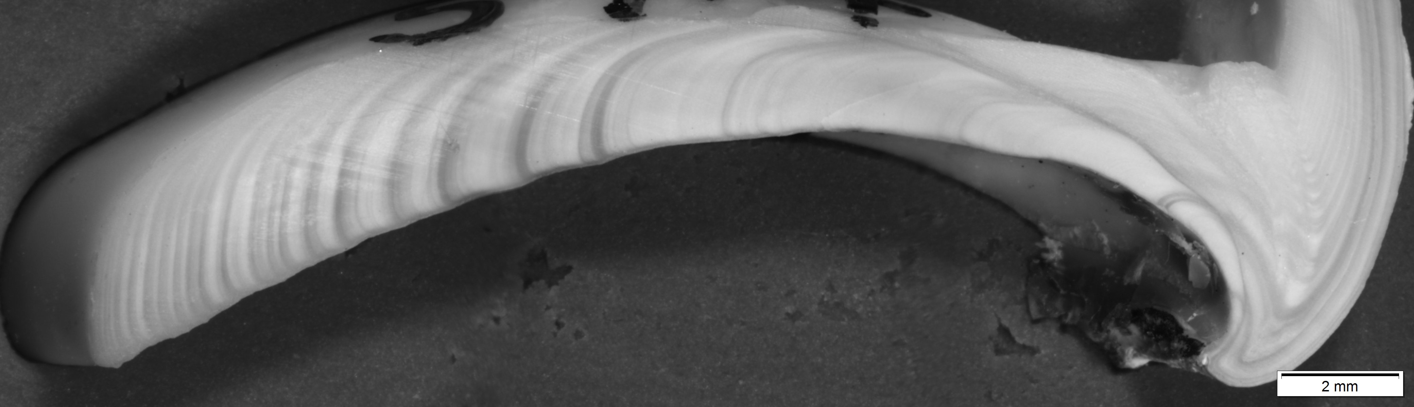
2
Notes:
22y

Slide 7
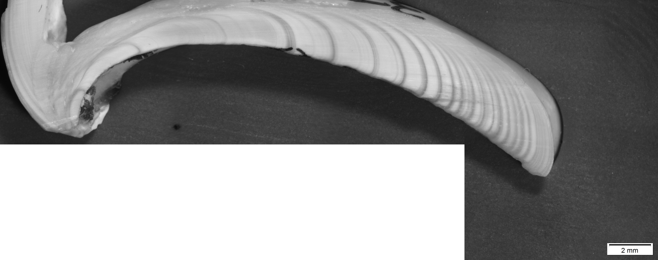
3
Notes:
26y

Slide 8
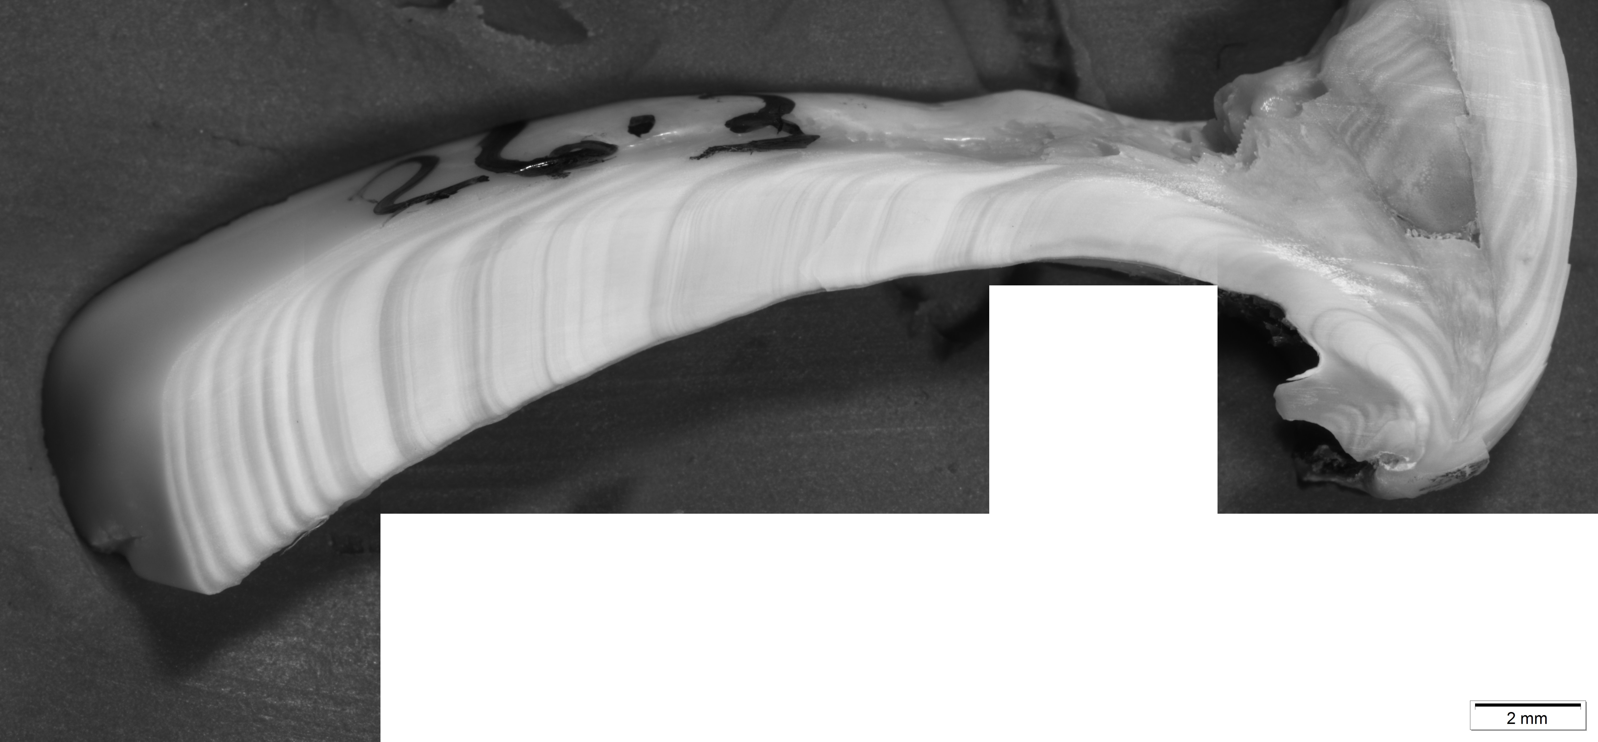
Perhaps one in here?
4
Notes:
15y plus ?another near origin?

Slide 9
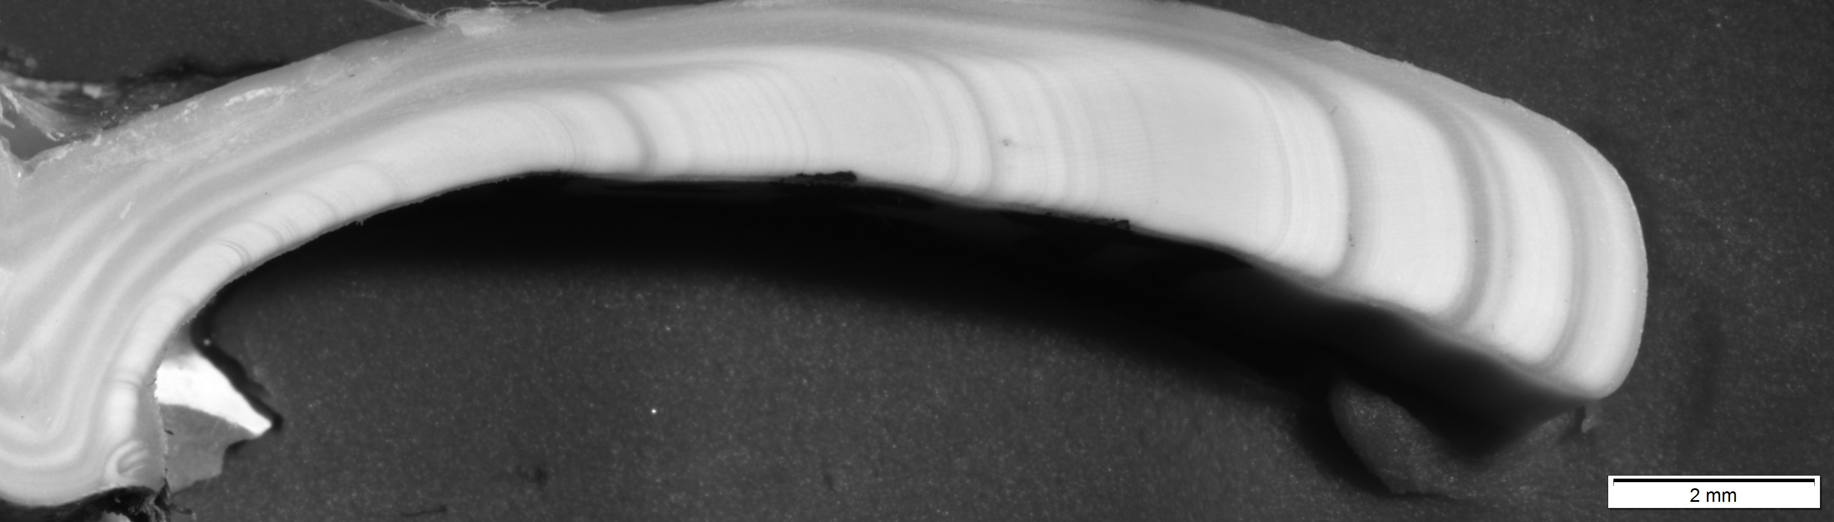
5
Notes:
10y

Slide 10
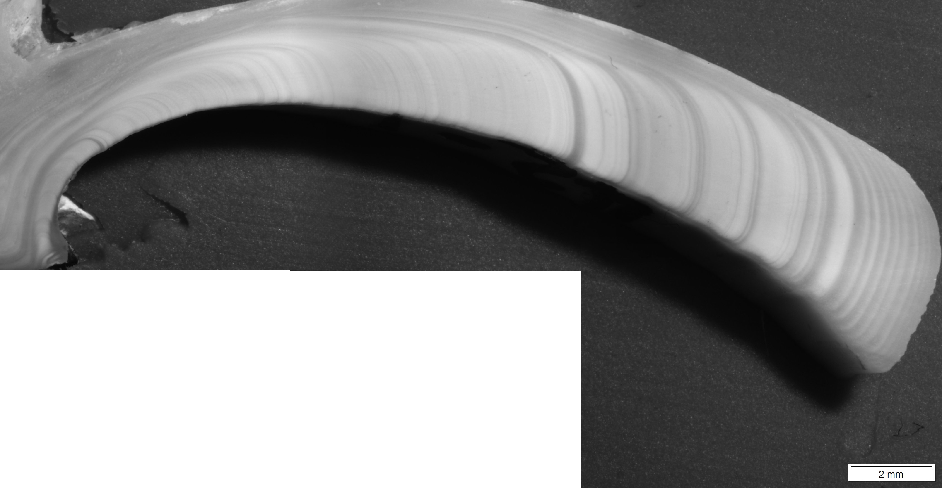
6
Notes:
18y

Slide 11
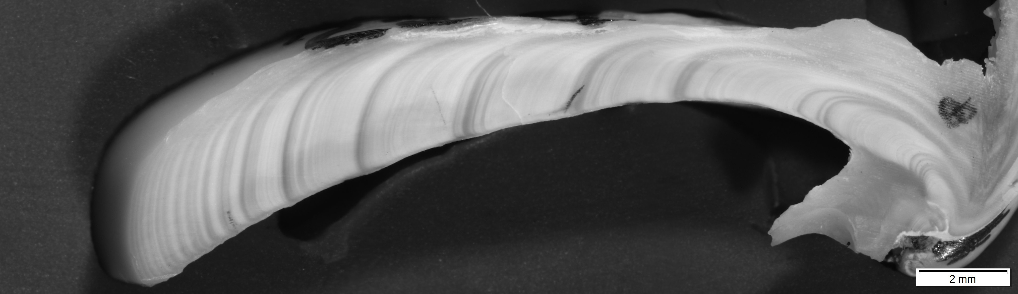
7
Notes:
18y

Slide 12
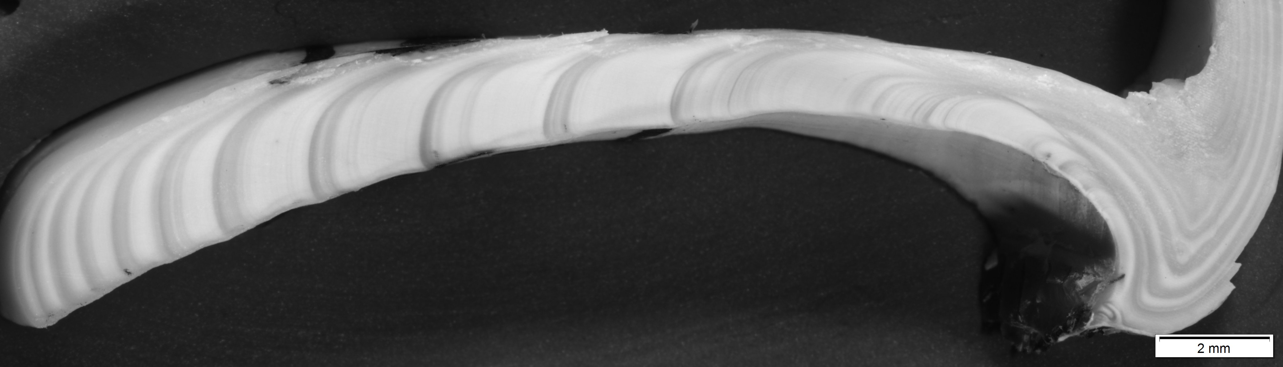
8
Notes:
14y

Slide 13
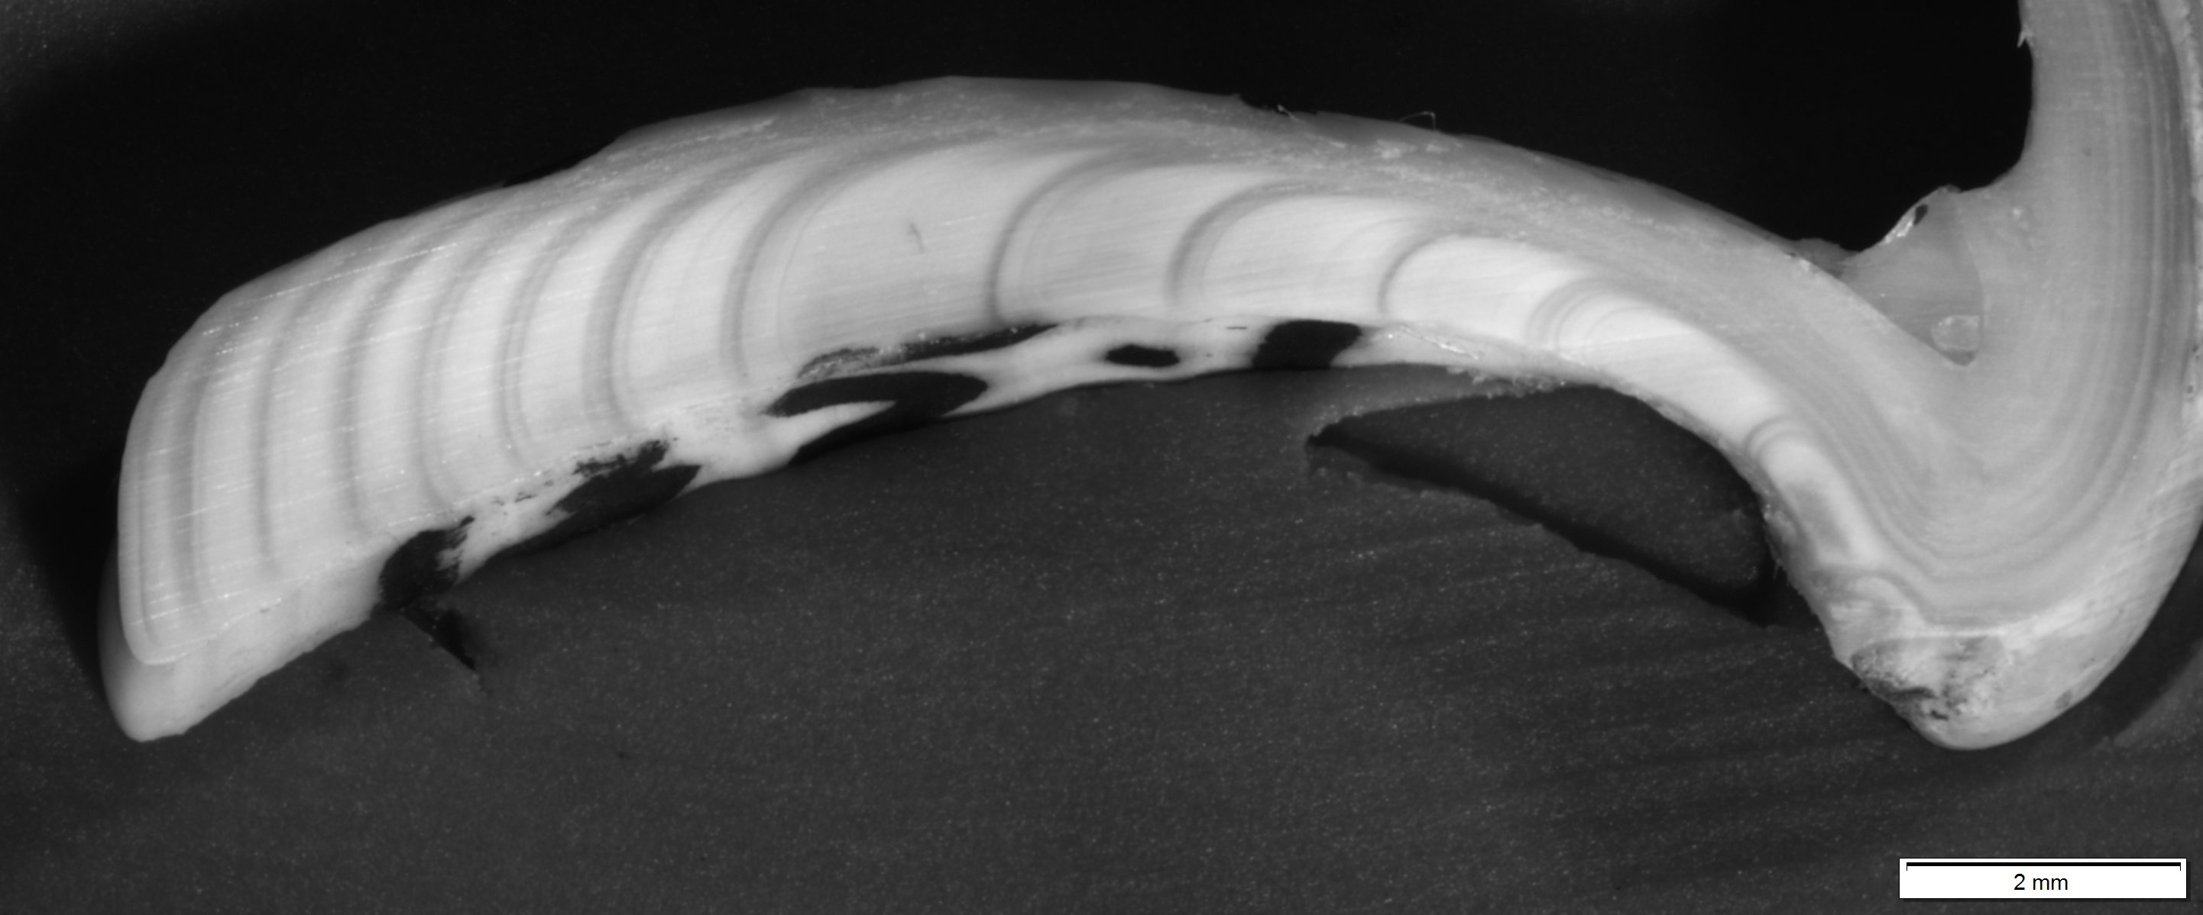
9
Notes:
14

Slide 14
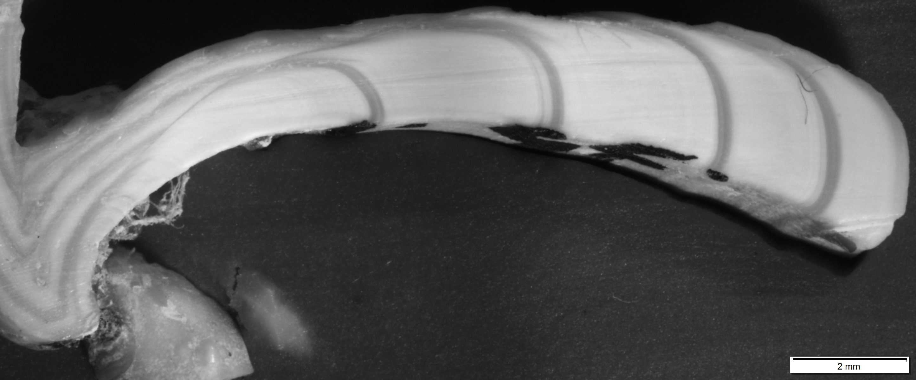
10
Notes:
8y

Slide 15
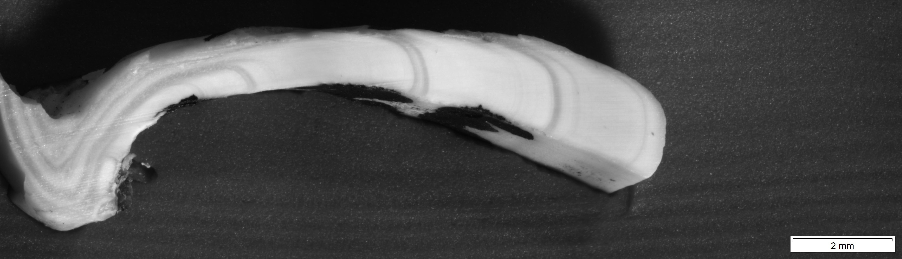
11
Notes:
6y

Slide 16
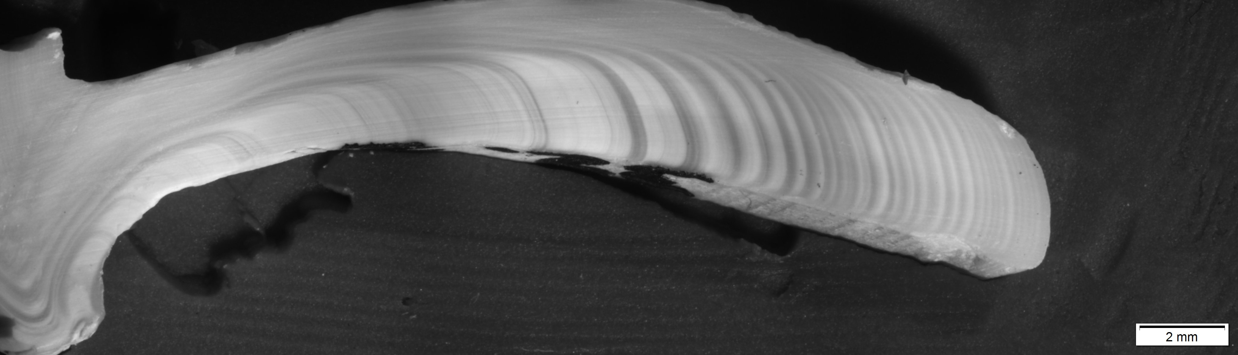
12
Notes:
31y – seems high but the lines are there.

Slide 17
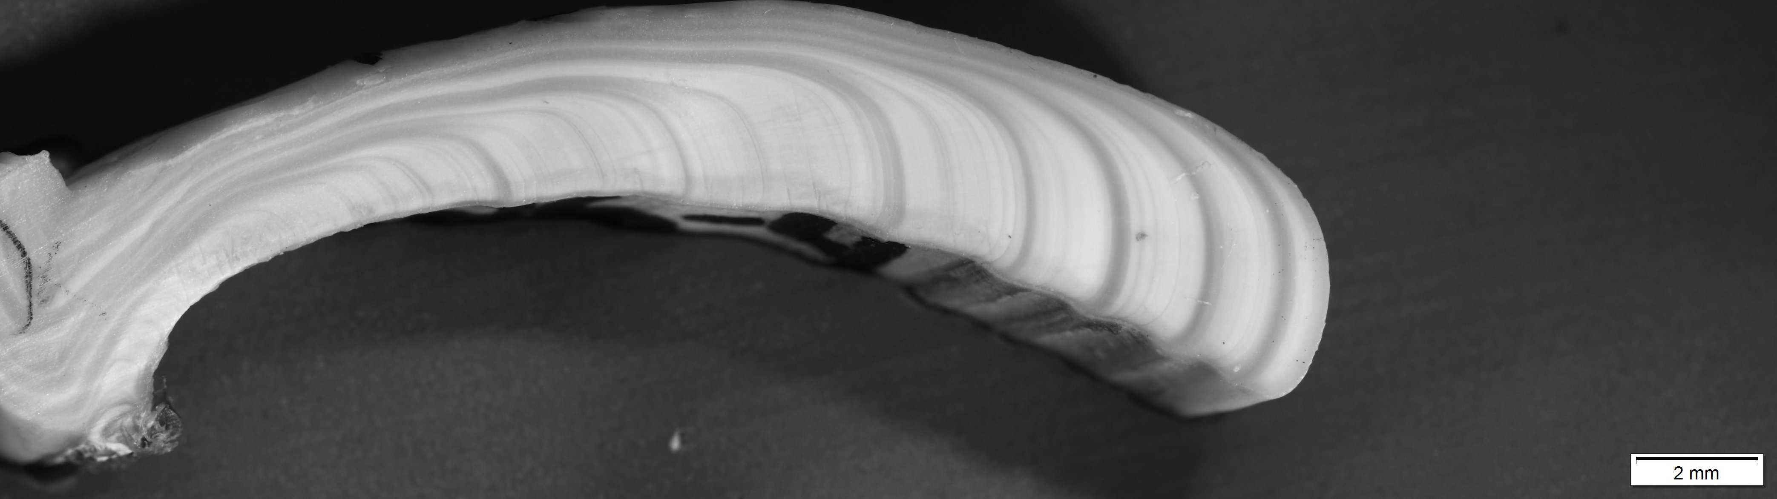
13
Notes:
11y

Slide 18
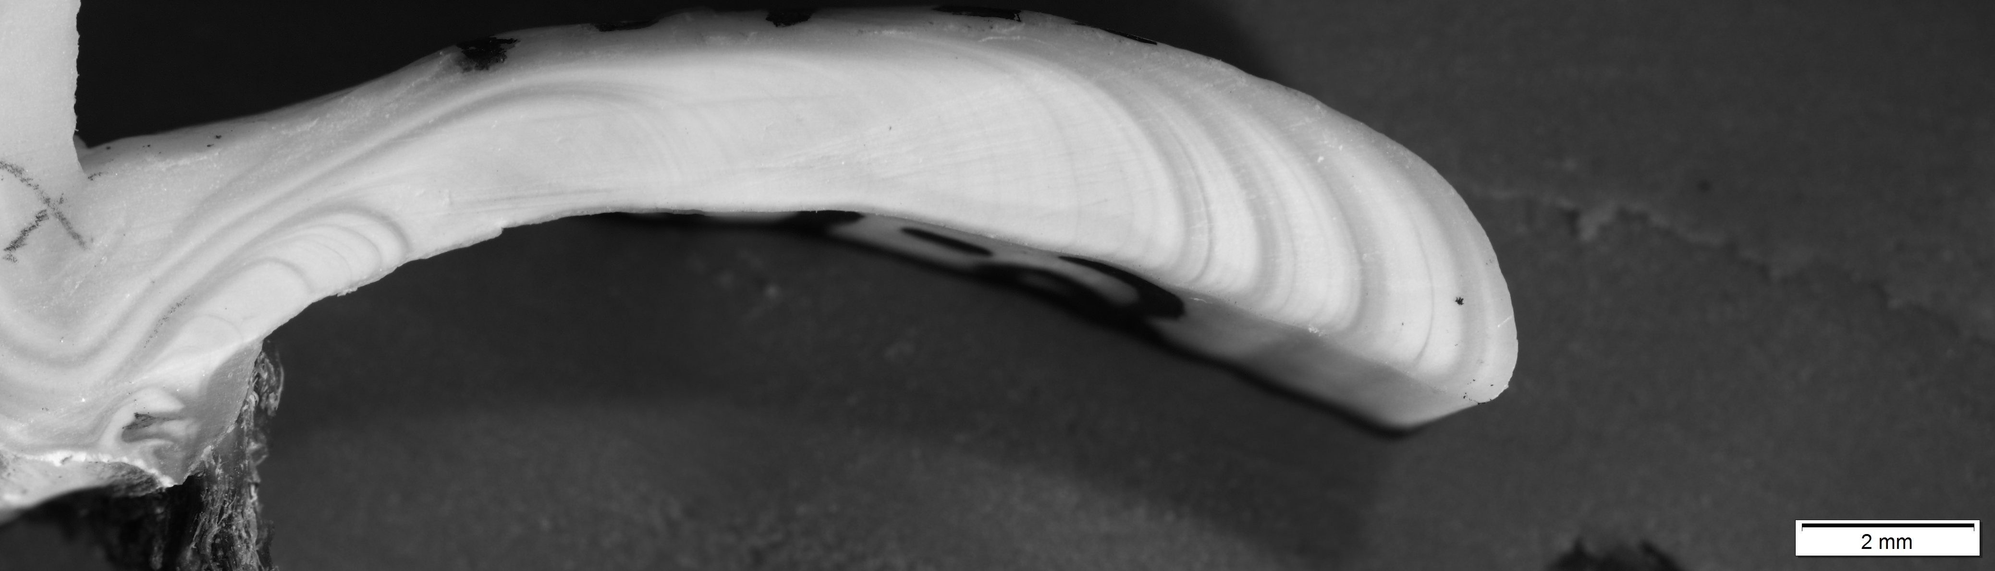
14
Notes:
9y

Slide 19
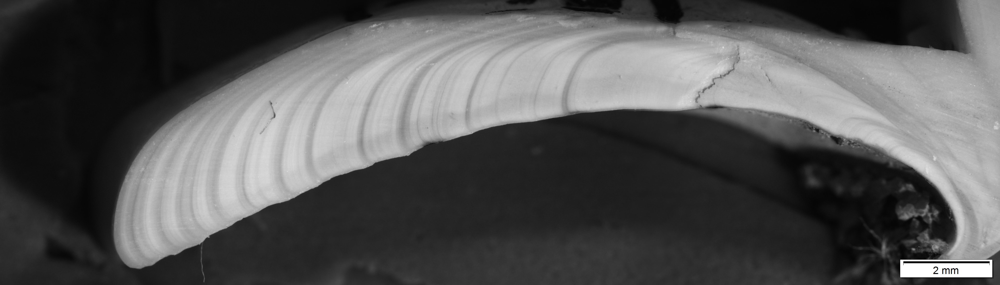
15
Notes:
12 y plus perhaps one more near the origin in the yellow circle.

Slide 20
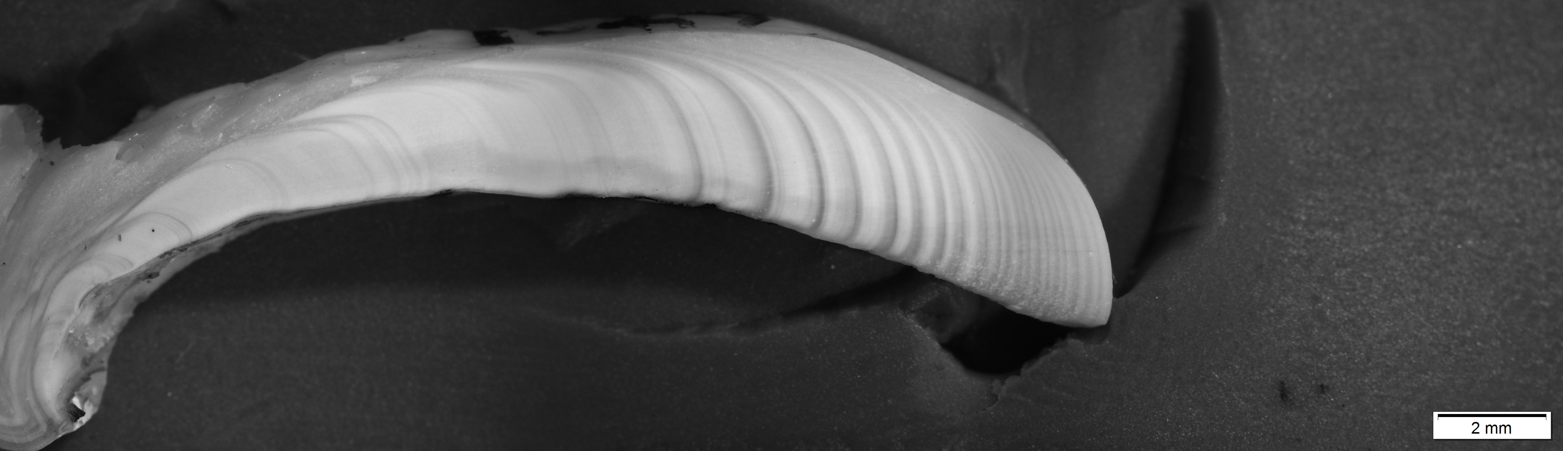
16
Notes:
25y

Slide 21
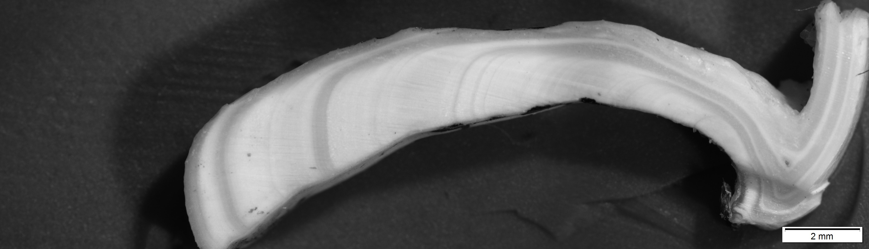
17
Notes:
7y

Slide 22
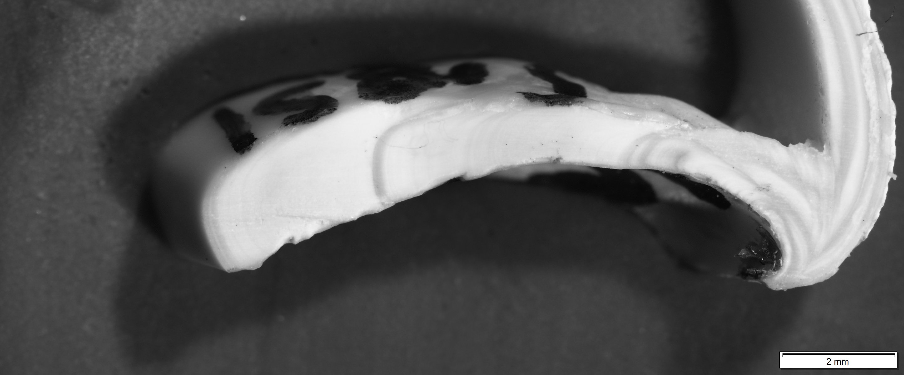
18
Notes:
4y

Slide 23
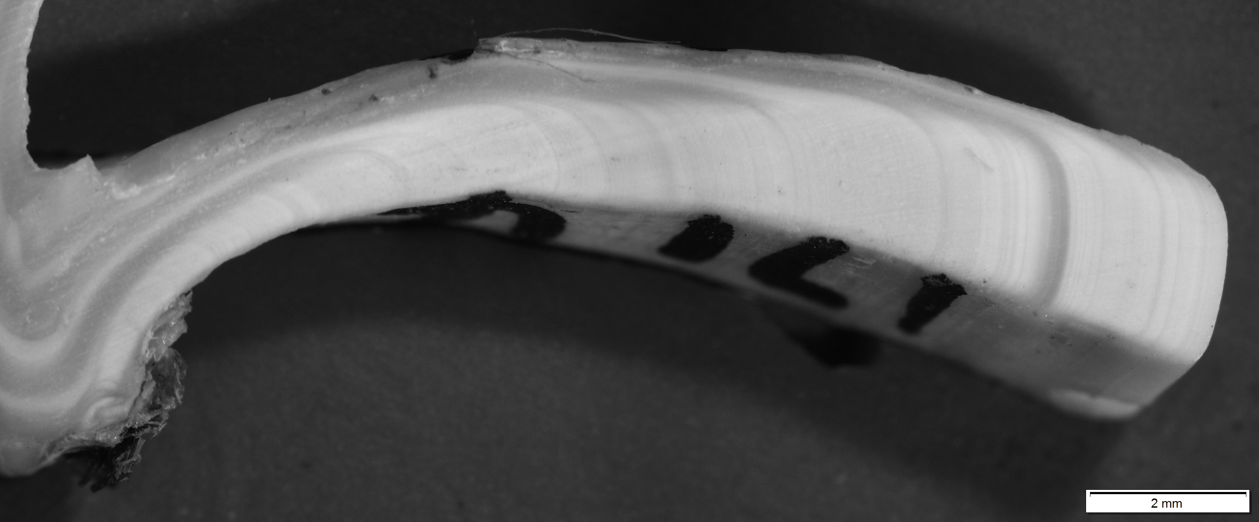
19
Notes:
4y – this may be 5

Slide 24
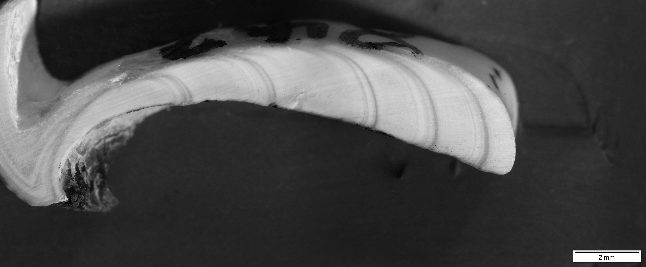
Convergence?
20
Notes:
5y, but note the way two lines in yellow converge, so I suspect another one near the origin

Slide 25
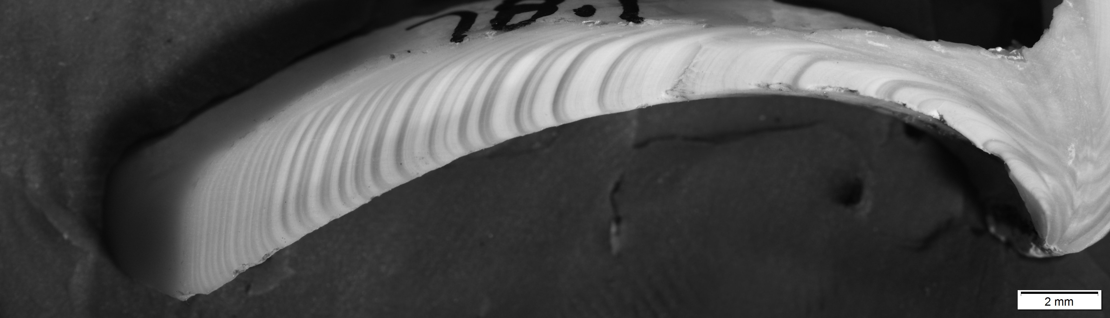
21
Notes:
31y

Slide 26
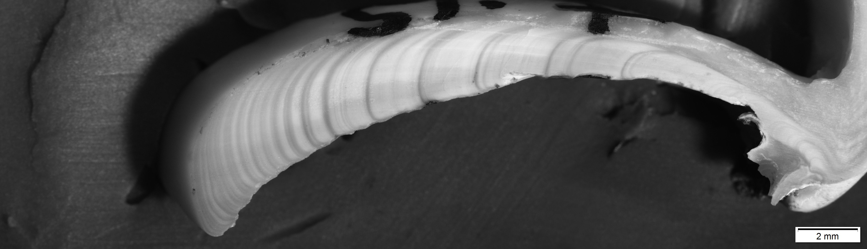
22
Notes:
19y

Slide 27
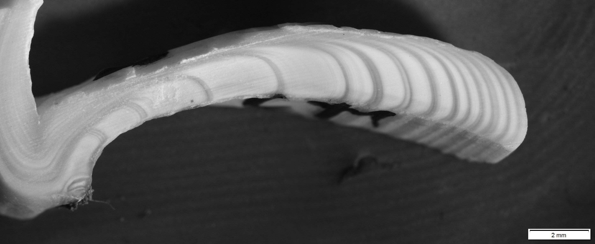
23
Notes:
15y

Slide 28
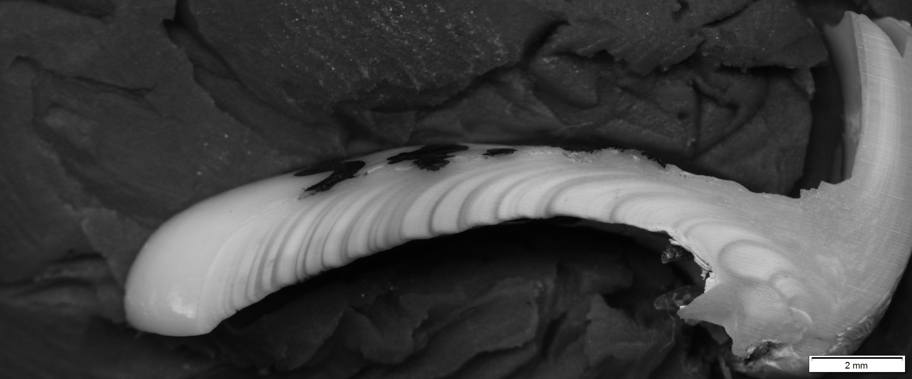
24
Notes:
21y

Slide 29
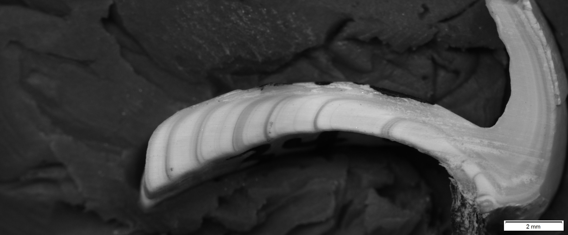
25
Notes:
9y

Slide 30
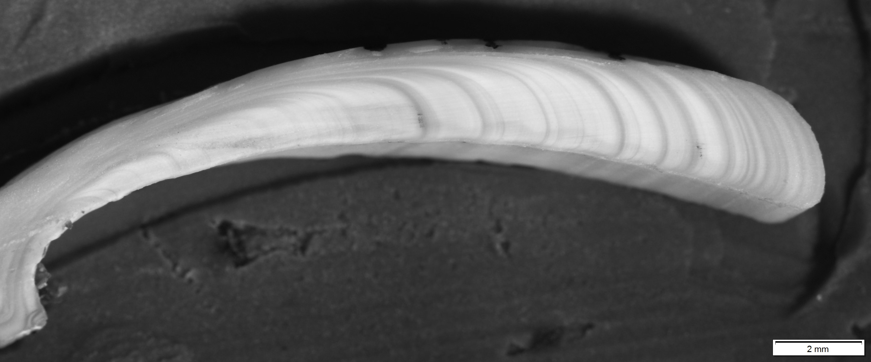
26
Notes:
16y

Slide 31
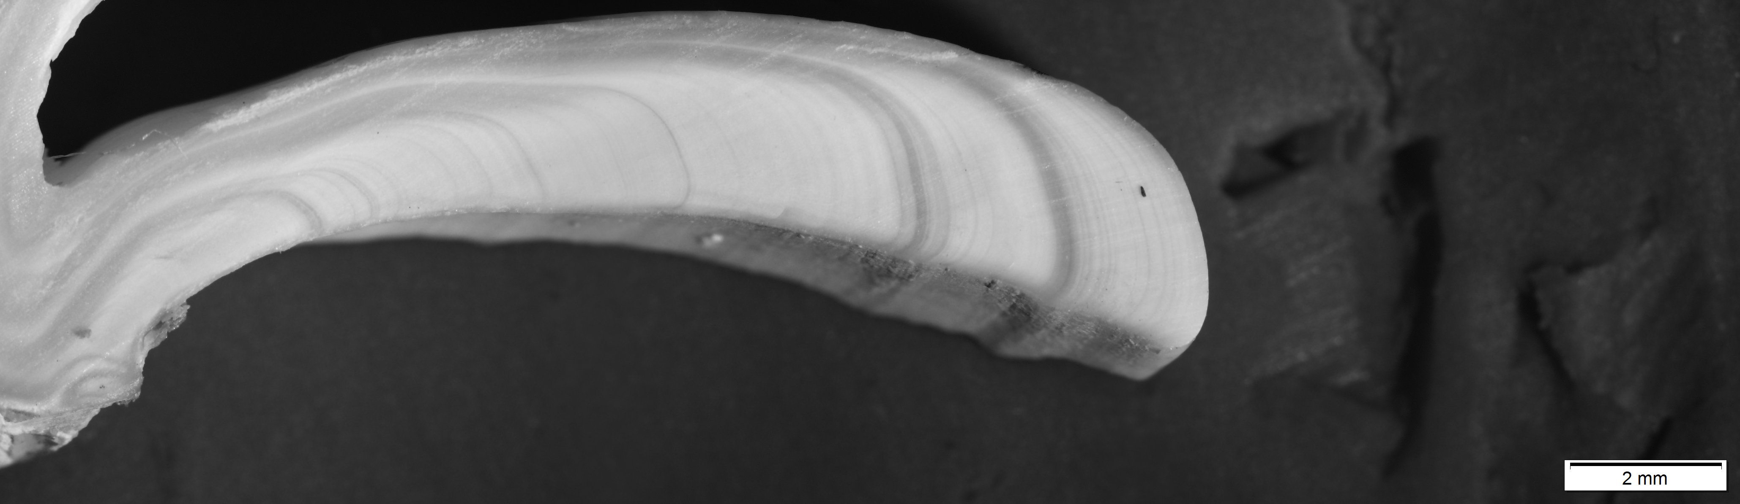
27
Notes:
6y

Slide 32
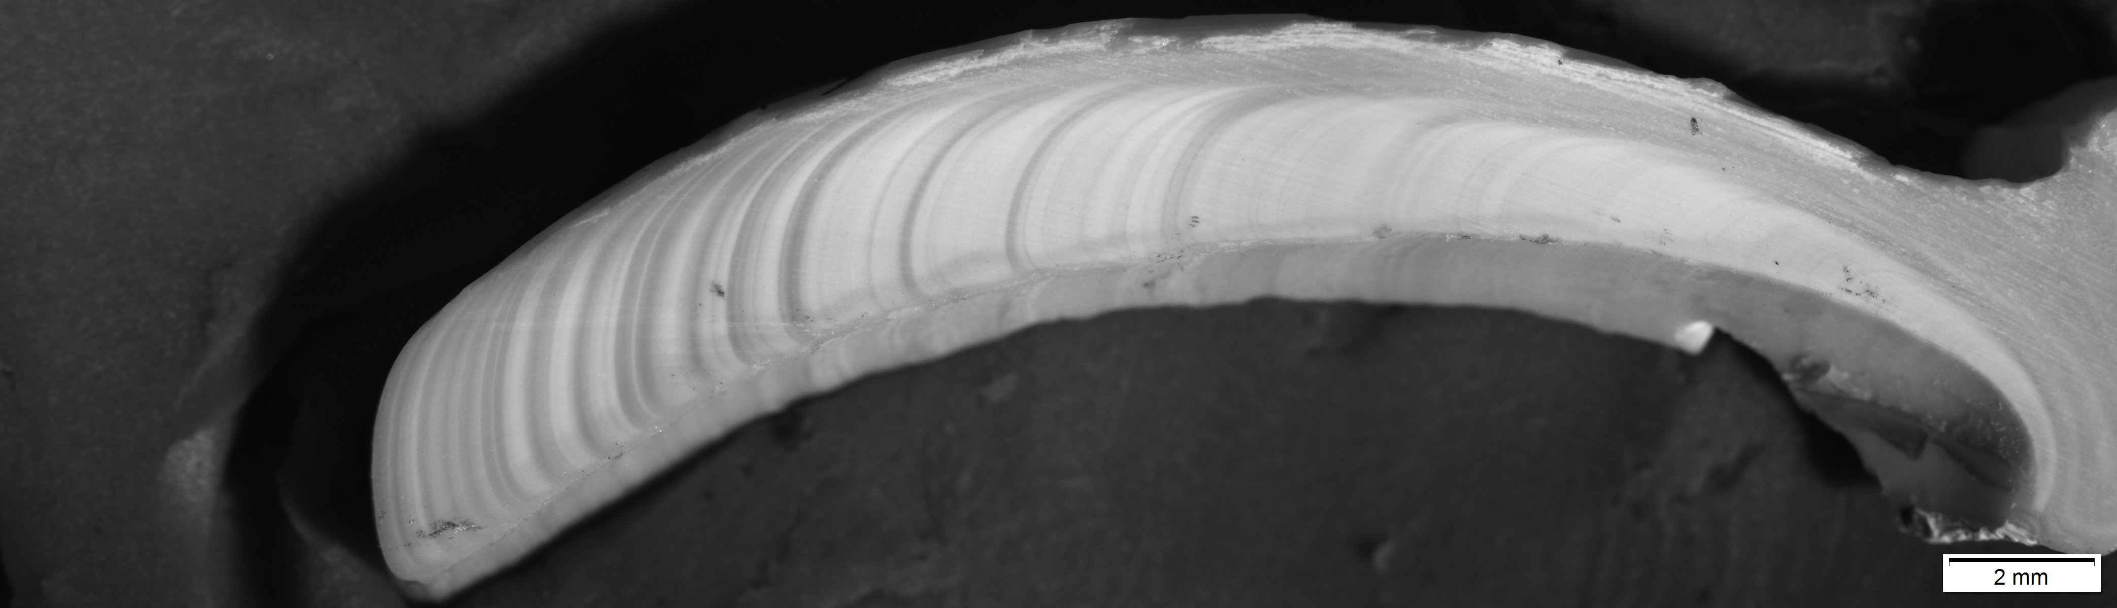
Line(s) missing in here ?
28
Notes:
16y + missing lines

Slide 33
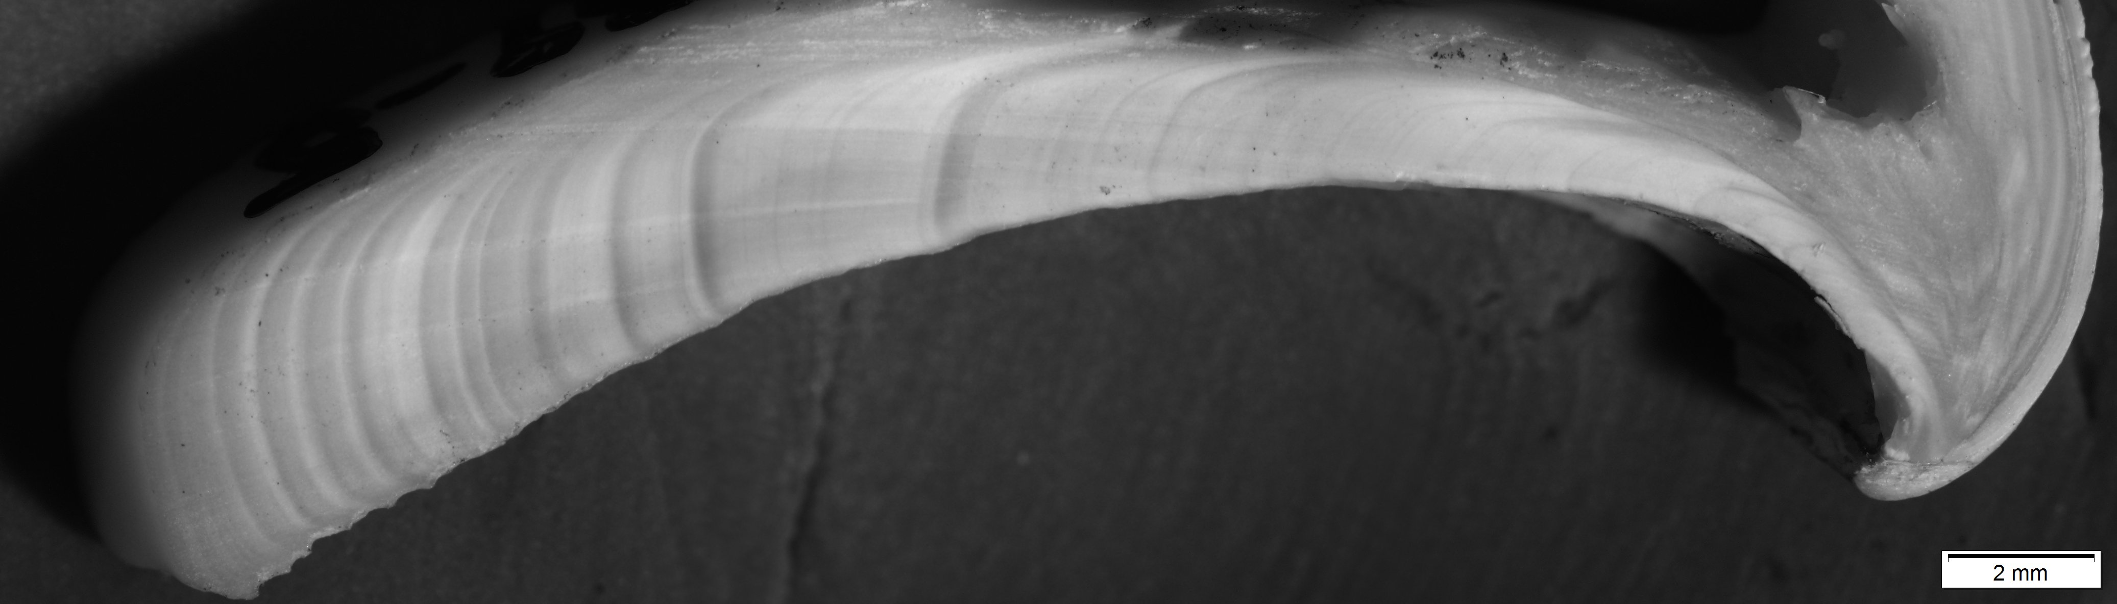
29
Notes:
15y

Slide 34
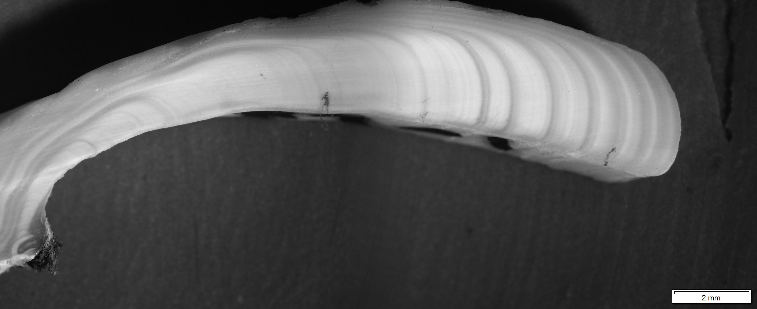
30
Notes:
14y

